Slide 1

SPI CONTROLLER IMPLEMENTATION USING ZEDBOARD
BACHELOR OF TECHNOLOGY
IN
ELECTRONICS AND COMMUNICATION ENGINEERING
DEENBANDHU CHHOTU RAM UNIVERSITY OF SCIENCE AND TECHNOLOGY, MURTHAL, SONEPAT
ARUN (21001003903)
SONU (21001003910)
YUKTI (21001003912)
SUJEET(20001002054)
Under the Supervision of
DR. VIKAS NEHRA
(Assistant Professor, ECED, DCRUST, Murthal)

Slide 2
INTRODUCTION
SPI stands for SERIAL PERIPHERAL INTERFACE CONTROLLER.
Serial peripheral interface (SPI) is an interface commonly used in computers and embedded systems to facilitate short-distance communication between a microcontroller and one or more peripheral ICs. Multiple transmission lines or signal wires connect the SPI chips, enabling the microcontroller to exchange data with the peripherals.
Motorola developed the SPI architecture in the 1980s to provide an interface that supports serial, synchronous and full-duplex communications:
SPI's flexibility, speed, and relatively simple implementation make it a popular choice for various applications, such as connecting sensors, displays, memory devices, and other peripherals to microcontrollers and embedded systems.

Slide 3
OBJECTIVES
The primary objectives of this project are:-
High-Speed Data Transfer: Create an SPI Controller capable of achieving high-speed data transfer rates while adhering to timing constraints. Consider strategies to optimize clock synchronization and data transmission efficiency.
Flexible Device Interfacing: Develop the controller to support interfacing with various types of peripheral devices, such as sensors, memory modules, and displays. Implement individual chip select lines to enable selective communication with multiple slaves.
Reliable Communication: Implement error-checking mechanisms to ensure reliable data transfer between master and slave devices. Investigate techniques to detect and recover from potential data corruption or transmission errors.

Slide 4
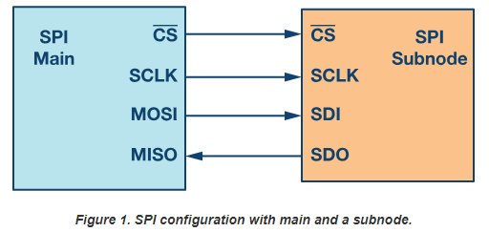
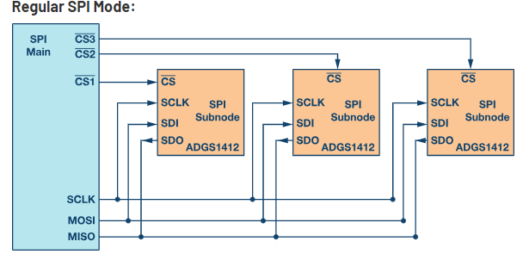
BASIC BLOCK DIAGRAM
Figure 1

Slide 5
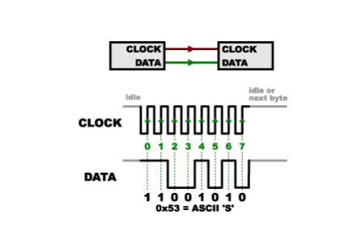
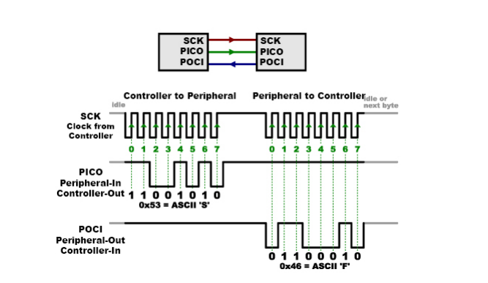
TIMING DIAGRAM
TRANSMITTING THE DATA
RECEIVING THE DATA
Figure 1.1

Slide 6
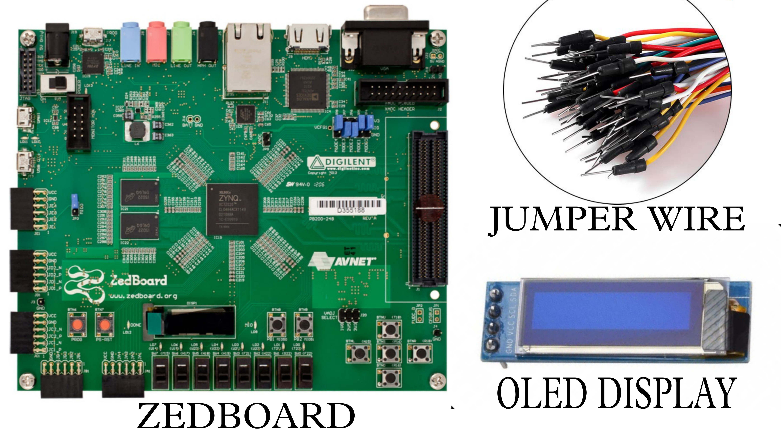
COMPONENTS
Figure 1.2

Slide 7
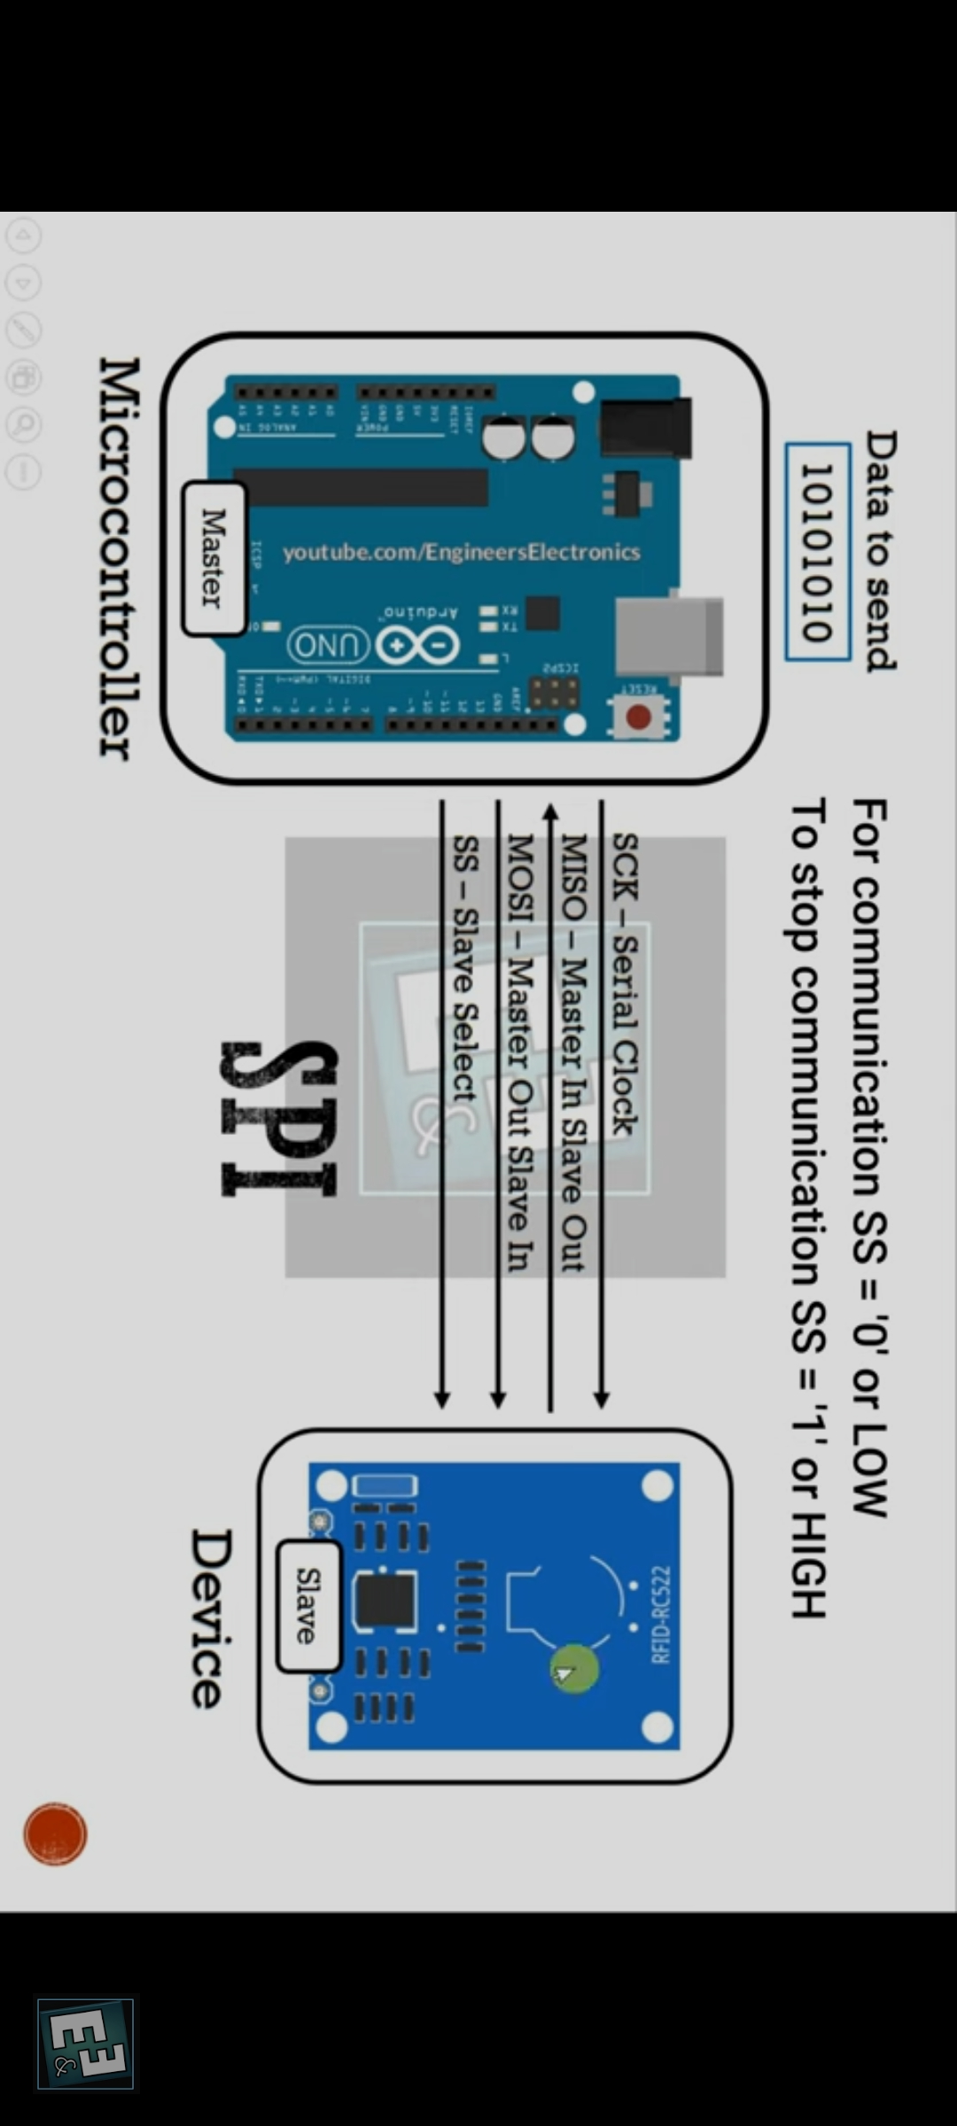
SPI CONTROLLER USING ARDUINO
Figure 1.3

Slide 8
ROLE OF PROJECT
Upon successful completion of the project, the SPI Controller should demonstrate:
Improved data transfer speeds and reduced latency compared to existing communication methods.
Compatibility with diverse peripheral devices commonly used in embedded systems.
Reliable data exchange with error detection and recovery mechanisms.
Efficient utilization of hardware resources for communication.
Clear documentation and guidelines for integrating and utilizing the SPI Controller in different applications.

Slide 9
SOFTWARE/HARDWARE TOOLS
Software tools:-
Xilinx Vivado.
Verilog hardware description language(HDL)
Hardware tools:-
Zed board (Diligent Xilinx).
OLED Display
Jumper Wire

Slide 10
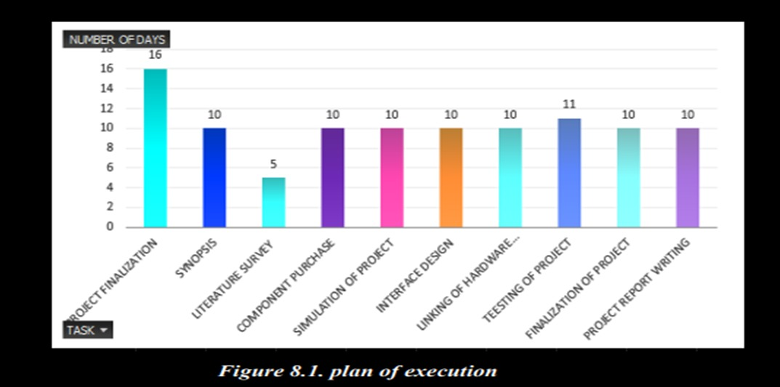
PLAN OF EXECUTION
Figure 1.4

Slide 11
APPLICATIONS
Sensor Interfacing / communication system.
Memory Devices
Display Modules
Wireless Communication Module
Motor Control
Analog to Digital Converters(ADCs)
Digital to Analog Converters(DACs)
Security Systems

Slide 12
REFERENCES
https://www.techtarget.com/whatis/definition/serial-peripheral-interfaceSPI . “
https://www.javatpoint.com/spi-protocol
https://www.analog.com/en/analog-dialogue/articles/introduction-to-spiinterface.html.
https://learn.sparkfun.com/tutorials/serial-peripheral-interface-spi/all.
https://www.xilinx.com/products/boards-and-kits/1-8dyf-11.html
https://ieeexplore.ieee.org/document/9250981

Slide 13
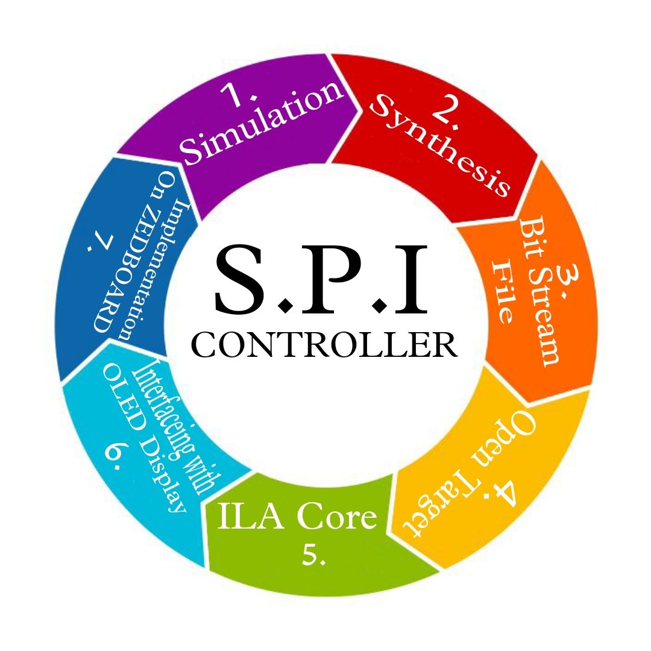
WORKDONE
There are certain steps involved for implementing the S.P.I. Controller for data communication :-

Slide 14
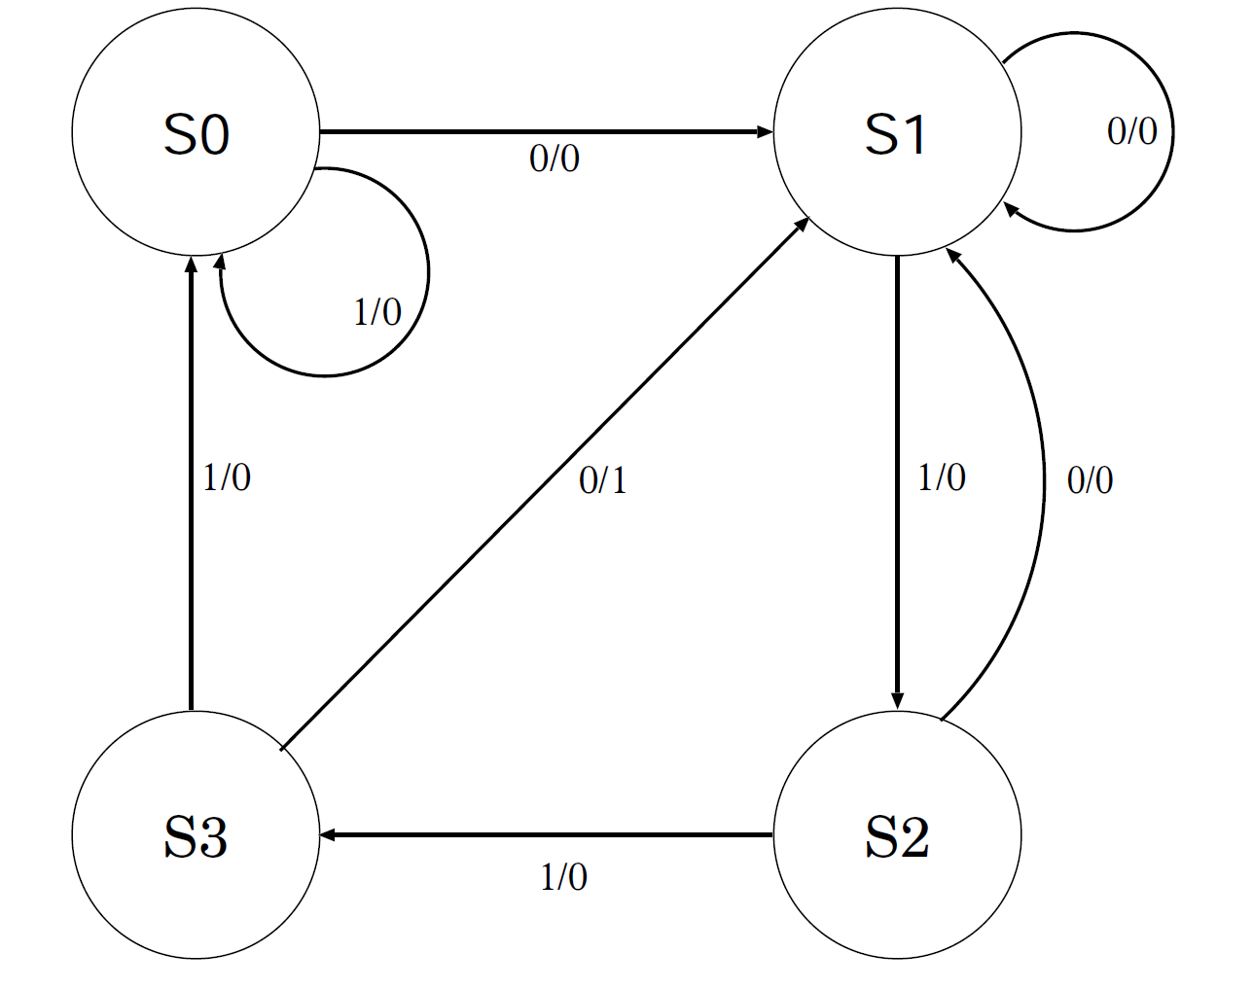
SIMULATION
The simulation is done using XILINX VIVADO software. The diagram of simulation at each step is given below according to FSM diagram :-
Figure 1.5

Slide 15
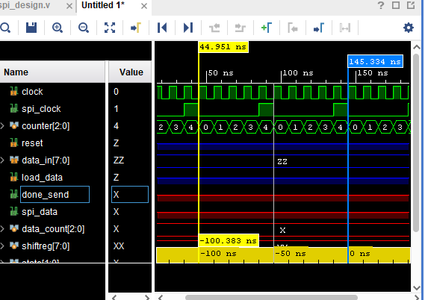
SIMULATION STEPS
INPUT :-
Initially clock=0 i.e. 100 MHZ ,spi_clock=1 i.e.10 MHZ
Counter starts incrementing up to four bit after that it starts toggling as data is transmitted to next state during negative edge clock for 100 ns time as per the required data sheet according to spi_clock.
Figure 1.6

Slide 16
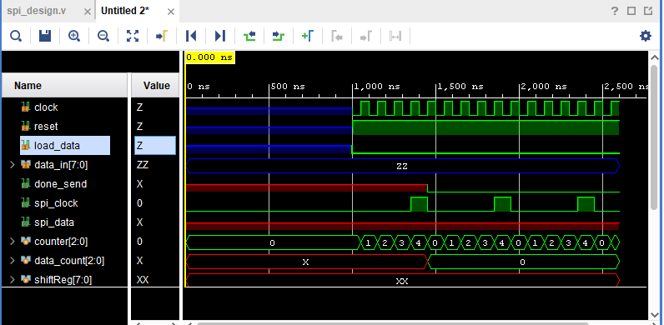
SIMULATION-I
INPUT :-
Clock =0, reset = 1,
data_in = 0, load_data=0.
Counter starts incrementing as well as data_count starts counting with respect to data_in.
Figure 1.7

Slide 17
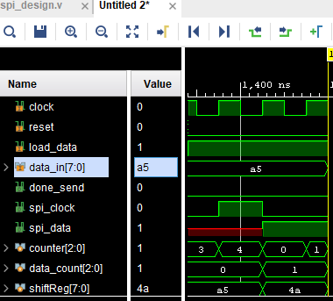
SIMULATION - II
INPUT :-
Reset = 0, load_data = 1,
data_in = a5.
OUTPUT :-
Data will be stored in shiftReg[7:0] and spi_clock work accordingly as well as counter also.
Figure 1.8

Slide 18
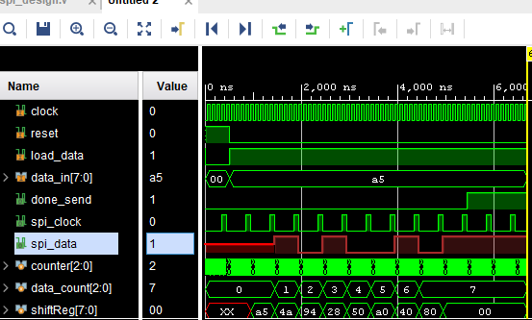
SIMULATION -III
The same input is taken with respect to previous input .Here, the input data is given multiple times that should be stored in shift register.
Figure 1.9

Slide 19
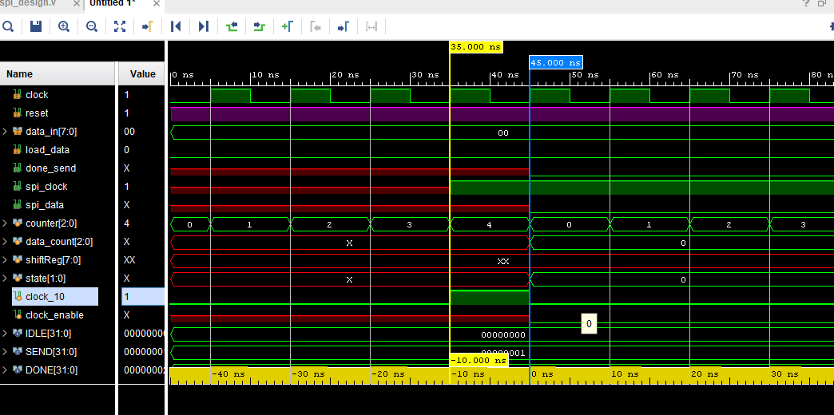
SIMULATION -IV
INPUT :-
Clock 0 to 1 for 10ns in each transition.
Reset = 1, data_in = 0,load_data = 0.
OUTPUT :-
Spi_data is not obtained .ideally initialized to zero but spi_clock is running as data is transmitted upon spi_clock initially.
To remove the spi_data before negedge then clock_10 which is run for 10ns during transition of clock from positive to negative. Hence clock_10 declared with some control signals.
Figure 1.10

Slide 20
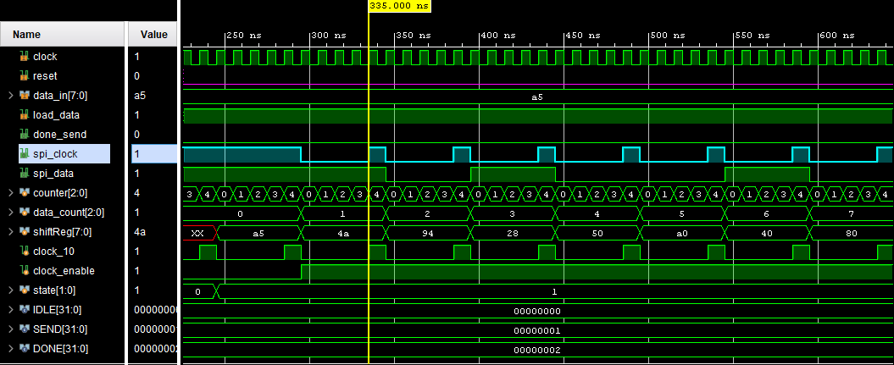
SIMULATION -V
The output data will be displayed on OLED by taken account of spi_data with respect to spi_clock(negative edge).
CE(clock enable is required to change the states of finite state machine).
Figure 2.

Slide 21
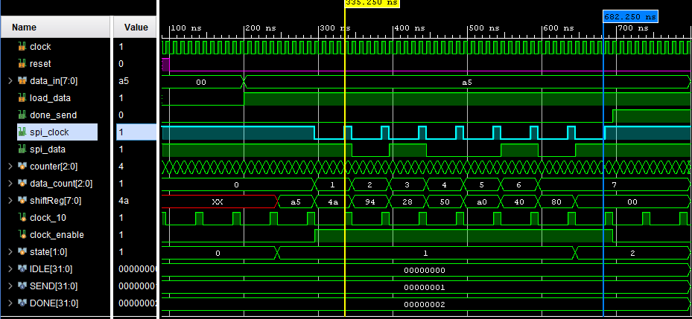
SIMULATION -VI
The Output Will Be Displayed In Accordance With The Spi_data By Taking Consideration Of Spi_clock Represented Between Yellow And Blue Line.
Figure 2.1

Slide 22
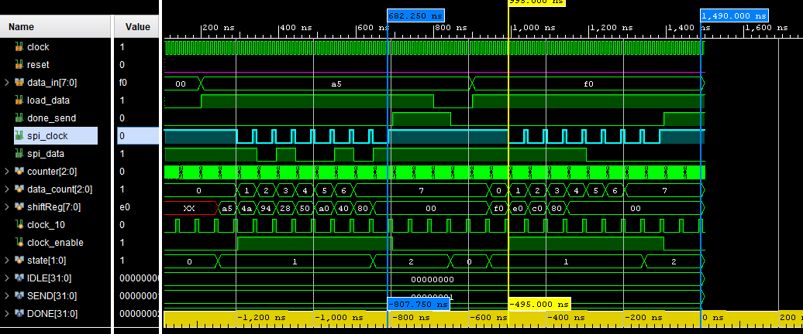
FINAL SIMULATION OBSERVATION
Figure 2.2

Slide 23
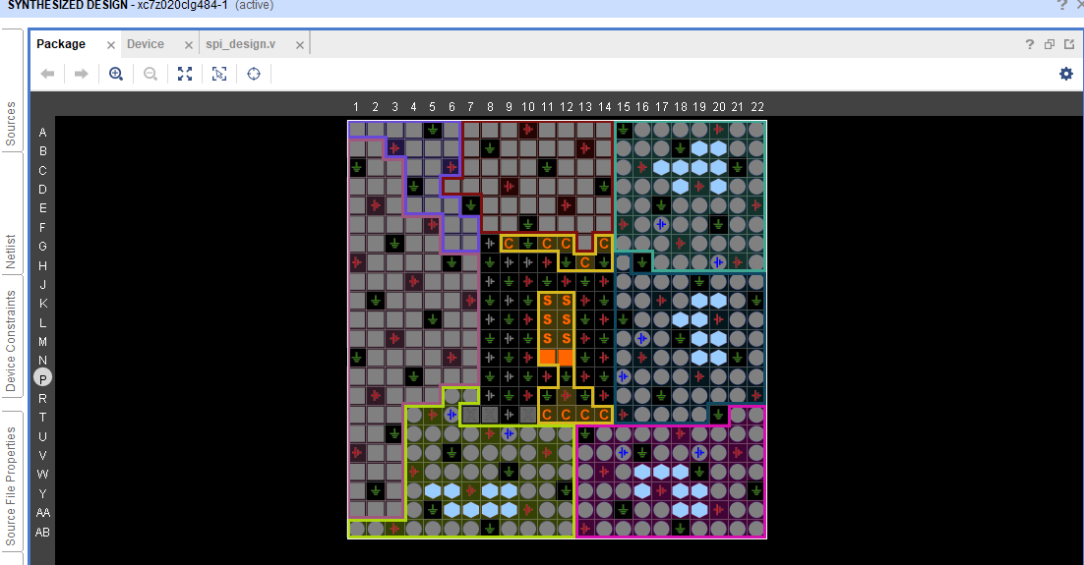
INPUT-OUTPUT FLOORPLANNING
Figure 2.3

Slide 24
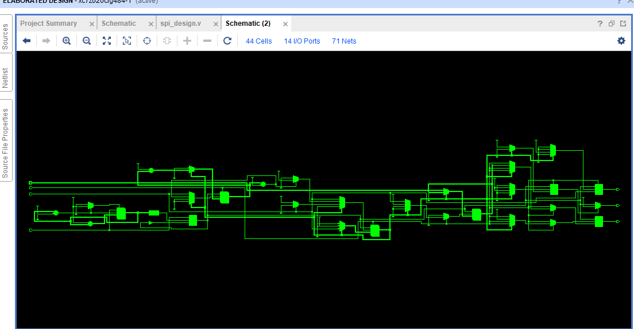
SYNTHESIS-I
Synthesis of SPI Controller is obtained after performing the simulation process using Xilinx Vivado.
Figure 2.3

Slide 25
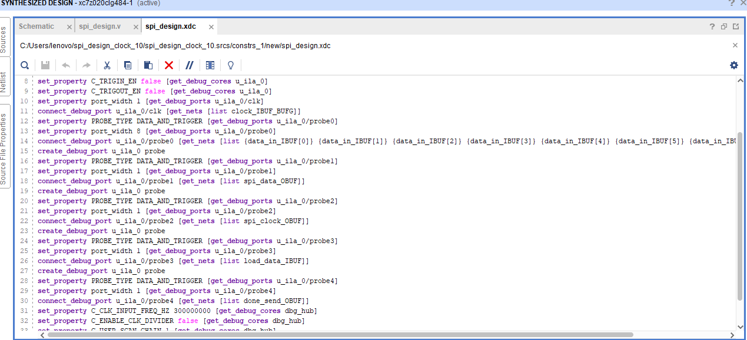
CONNSTRAINTS FILE
The Xilinx constraints file or bitstream file generation is necessary to generate before implementing the any project on Zedboard.
Figure 2.4

Slide 26
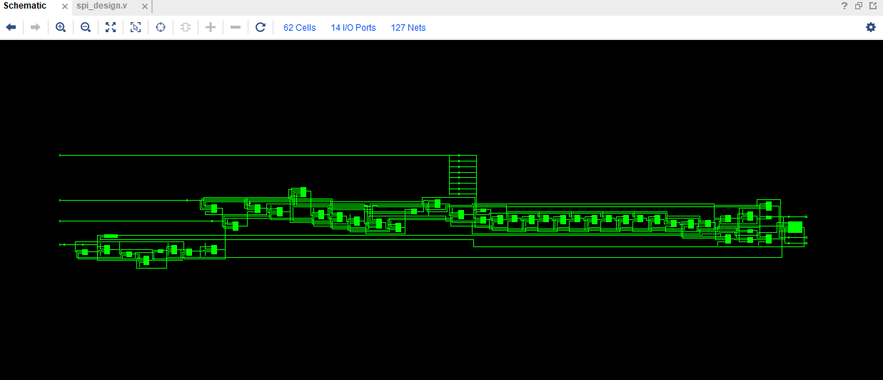
SYNTHESIS AFTER THE CONSTRAINTS FILE
Figure 2.5

Slide 27
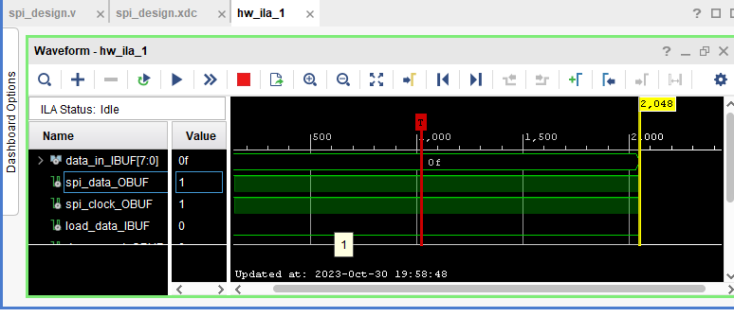
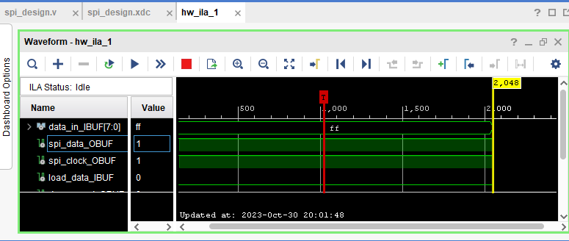
DEBUGGING USING ILA IP CORE
Figure 2.6
Figure 2.7

Slide 28
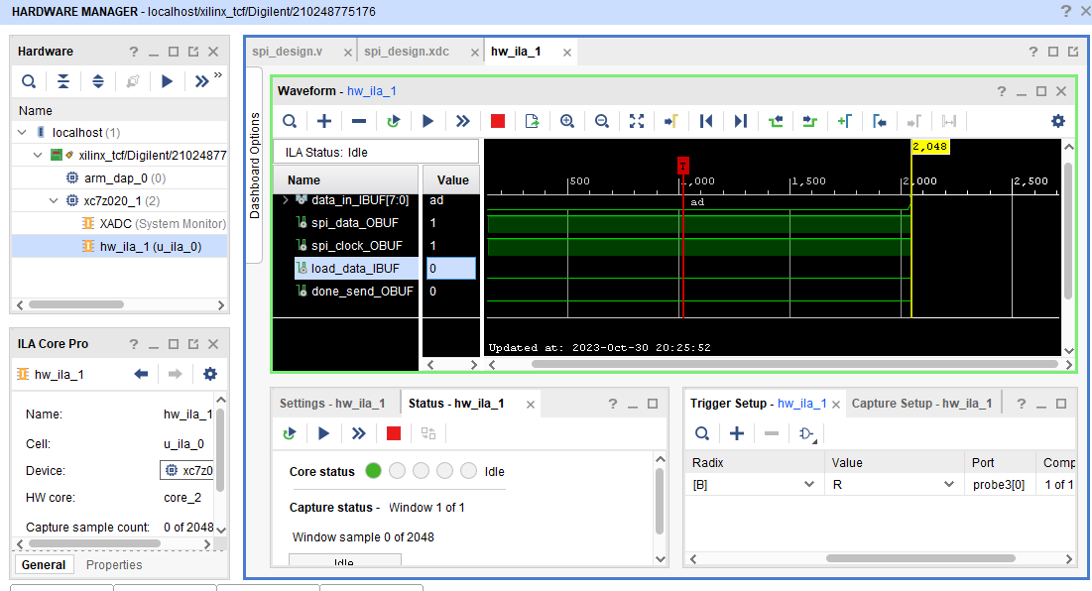
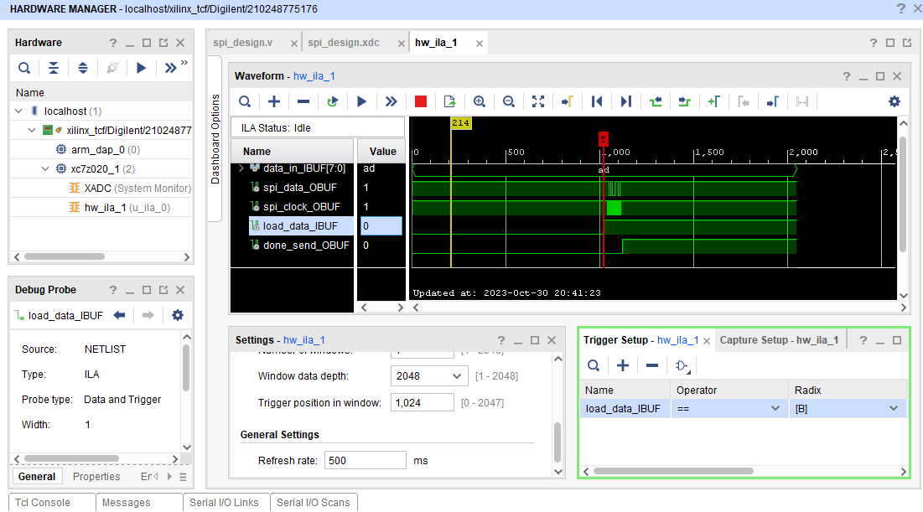
DATA OBTAINED USING OLED ON WAVEFORM
Figure 2.8
Figure 2.9

Slide 29
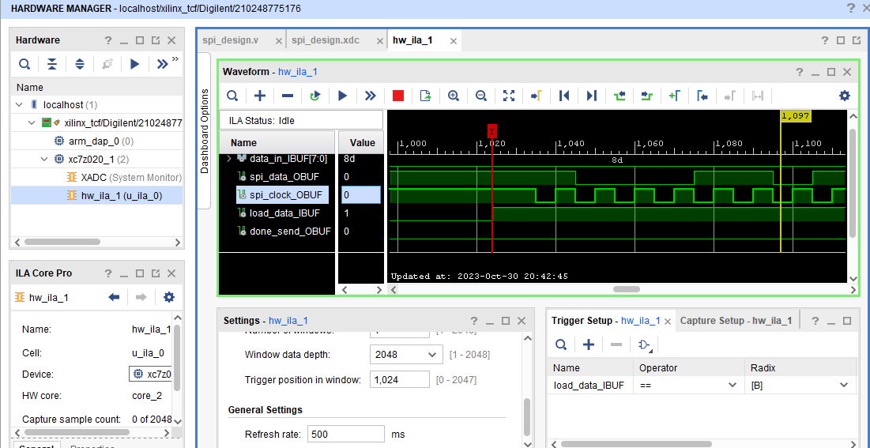
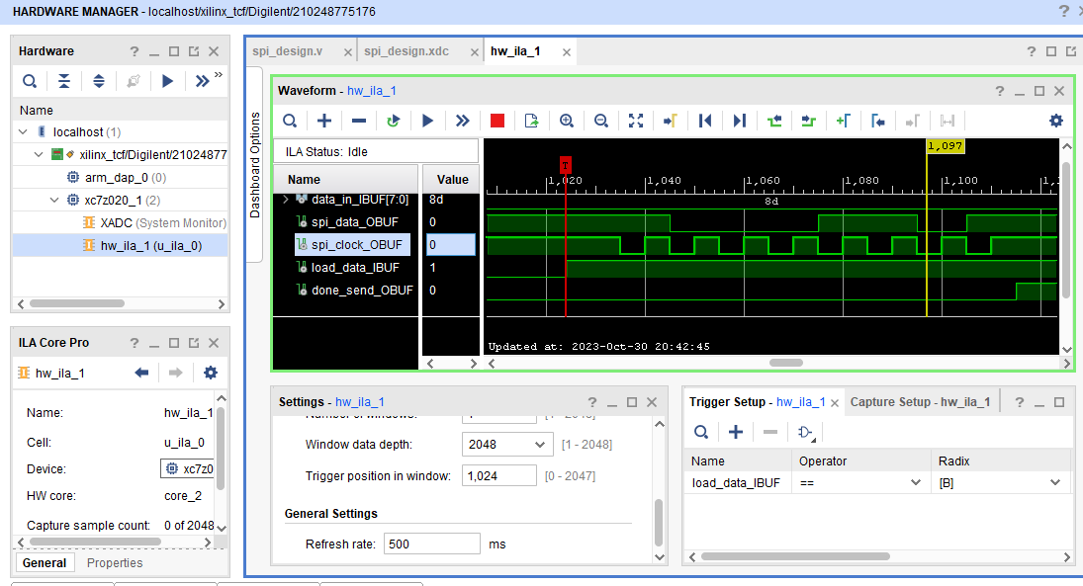
DATA CHANGES ON WAVEORM BUT INSERTED USING OLED
Figure 2.10
Figure 3.

Slide 30


